Slide 1

Bulgarian Presidency of the Council of the EU
Policies and support for persons with disabilities
Lilia Stoyanovich
Director General, DG EFIPP
Ministry of Labour and Social Policy

Slide 2
BULGARIAN PRESIDENCY OF THE COUNCIL OF EU
Four priority themes in the area of employment, labour mobility and social policy
Future or work
Opportunities for support from the European Social Fund post 2020
Early childhood development policies
People with disabilities – full members of the society
Notes:
1. The future of work and the work-life balance are key themes to be addressed in EU policies and EU funding instruments.
Digitalization and new technologies will impact jobs, skills, wages, and the nature of work itself. It will be necessary to enable smooth transitions between jobs and occupations and invest in upskilling and reskilling of the workforce in order to meet the rapidly changing demands of the labour market
Development of practical knowledge and skills from an early age;
The right skills for new jobs and the impact of digitalisation and automation on the labour market;
New forms of work: Fair working conditions and adequate social protection.
Bulgaria’s vision of the future of work:
identifying the right skills for the new jobs;
better planning and linking the policies in the field of education, training and employment;
emphasis on youth employment, skills and competencies needed for the future labour market
2. Continuing targeted EU aid and investment to create sustainable jobs, economic growth and social cohesion
Support for measures aimed at combating unemployment, discrimination, social exclusion and poverty.
The provision of EU funds through the European Social Fund is an important prerequisite for overcoming the existing disparities between countries and regions.
For Bulgaria in the social sphere, it is essential to strengthen the effects of ESF investment.
3. Main objective of the National Strategy for Children 2008-2018 - providing conditions for effective exercise of the rights and improving the quality of life of the children, which are needed for their free and full personal development, early prevention measures. Support form ESF.
The theme is in line with a leading government priority for reducing poverty and promoting social inclusion through child and family support, including integrated early childhood development services.
4. Demographic trend towards aging of the population
Measures are needed to improve the quality of life, promote social inclusion and integration into society of disadvantaged groups with special needs and other vulnerable groups.

Slide 3
PEOPLE WITH DISABILITIES – FULL MEMBERS OF THE SOCIETY
Key priority - developing opportunities enabling people with disabilities to exercise their rights and freedoms to the fullest extent and without discrimination
Equal opportunities
Accessibility
Notes:
Equal Rights of People with Disabilities
A key priority
Equal opportunities – a priority for Bulgaria under the human rights aspect
Accessibility
Social inclusion
Full enjoyment of all rights and freedoms by persons with disabilities without any discrimination is set out as a major priority in a number of national and EU strategic documents and needs to be further developed and improved. The relevant legislation is consistently developed, thereby creating guarantees for non-discrimination in this field and ensuring equal opportunities for and social inclusion of persons with disabilities.
The European Union as well as Bulgaria is a party to the UN Convention on the rights of persons with disabilities and thus takes a number of measures for legislative amendments. The European Commission (EC) is the contact point for implementation of the Convention
The government pursues a consistent step-by-step policy in this field and the regulations of the Convention on the rights of persons with disabilities are thus subjected to profound discussion even before the ratification and this discussion is ongoing.
Equal opportunities are among Bulgaria’s priorities in the human rights field, laid down in a number of national and European strategic documents. The implementation of effective gender equality policies is important to the objectives of the National Development Programme: Bulgaria 2020 and the National Reform Programme.
Accessibility is included in several EU initiatives and some detailed accessibility requirements are incorporated in the EU legislation on specific projects and services or specific sectors.

Slide 4
SUPPORT TO THE PROCESS OF DEINSTITUTIONALIZATION /DI/
CHILDREN
DI
ELDERLY PEOPLE
NATIONAL FUNDING
OP HRD
Notes:
DI – complex process
Prevention from institutionalization – supportive community-based and home services;
Preparatory work and services to move children/elderly from the institutions and place them in newly opened services;

Slide 5
DI OF CHILDREN
National Strategy for Deinstitutionalization of Children in the Republic of Bulgaria - adopted in 2009
Action plan put into force (2010) - ERDF and ESF commenced jointly to support the National Strategy
Updated action plan - adopted in 2016
Goal: by the end of 2025, all specialized institutions for children and youth to be closed and new alternative services established
Notes:
Deinstitutionalization of childcare is one of the most important preconditions to guarantee the rights of children, who, for one reason or another, could not be raised by their biological families. In the past 20 years in Bulgaria, different concepts have been discussed and different interpretations have been accepted for the process of deinstitutionalization, yet the adoption of the National Strategy "Vision for deinstitutionalization of children in Bulgaria" has brought together all stakeholders around common principles and actions for a realistic deinstitutionalization of childcare.
Bulgaria is an example of good practice in implementing the reform, related to the prevention and deinstitutionalization of children.
Bulgaria is one of the few countries with an adopted strategy for transition from an institutional way of life to a community life.
The specific national goal is to complete the process in 2025 and not to have any institutions with children, accommodated in them.
Bulgaria is among those countries that actually take the children out of the institutions and close the institutions down.
In the process of prevention, Bulgaria is also a leader in the implementation of good practice with its policies to develop new standards for the quality of social services and deployment of foster care as an alternative to the placement in institutions.

Slide 6
DI MEASURES FOR CHILDREN - OUTCOMES
WITH ESIF SUPPORT
180 Family-type Residential Homes for 2,000 children and youth in operation
Created new community-based services for 1,700 children, ages 0-3
8 Family-type Residential Homes for 50 children, ages 0-3, in operation
More than 2,900 children have been placed with foster families, incl. almost 900 children former residents of the institutions
Specialized institutions for children with disabilities no longer exist

Slide 7
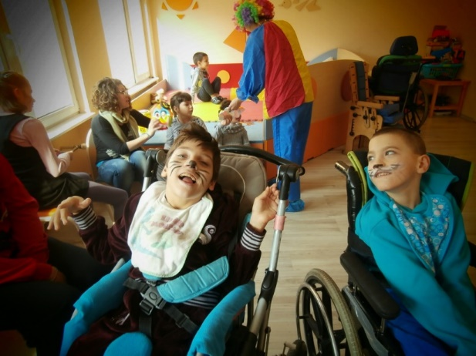
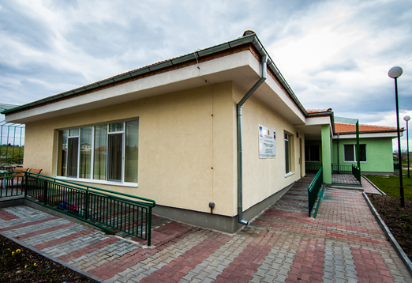
FINANCIAL COMMITMENT 2010-2017
346 million EUR state budget expenditure for child protection and social services for children
45 million EUR certified expenditure under the Regional Development
Operational Program
33 million EUR certified expenditure under the Human Resources Development Operational Program
Notes:
346 million EUR state budget expenditure –for this period this funding is according to the measures for child support in the national legislation:
Supportive services for children in the community
Early childhood development services, incl. support to families, guidance, counselling;
Services for social inclusion.

Slide 8
KEY POLICY MEASURES FOR VULNERABLE GROUPS
Social and integrated services – prevention of separation from families, integrated ECD and early intervention/prevention of disabilities services, patronage home-based care, etc.
Family care for children at risk who are not living with their biological parents and closure of all institutions for children
Social services and community support for children deprived from parental care living in institutions and children leaving the formal care system
Social, health and integrated services for children with disabilities – new community centers for children with disabilities and their families, establishing new specialized health-social services for disabled children in need of permanent and specific medical care; support to their families, etc.
Investments in social infrastructure and continued support from ESIF
Notes:
2. Foster care/adoption of children up to 3 years of age – national policy;

Slide 9
DI OF ELDERLY
National Strategy for Long-term Care - adopted in 2014
Action plan for the period 2018-2021, adopted in 2018 - ERDF and ESF commenced jointly to support the National Strategy
Goal: creating of conditions for independent and dignified life for elderly people and people with disabilities through replacing the institutional model of care by community-based social services
Notes:
ESIF, in support of the implementation of the National Strategy,
a system of community-based services throughout the country and family-like environment

Slide 10
ACTION PLAN MEASURES
Building a network of community-based and family-based social services (opening new social services in the community and at home, including providing hourly services in support to the social inclusion)
Development of innovative cross-sectional services for elderly and people with disabilities - rehabilitation, labour therapy and lifelong learning
Assessing the individual needs of every person and defining the need of support
Development of the independence and autonomy of people with mental disorders - ultimate goal
Support to service providers - supervision and training
Communication campaigns, awareness raising
Notes:
Providing home care for people with chronic illnesses – medical support, integrated services;

Slide 11
OPHRD 2014-2020
SUPPORT FOR PEOPLE WITH DISABILITIES
Support to the process of DI for children -
€ 141 million
Support to the process of DI of elderly people -
€ 131 million
Other measures - € 57 million
  Targeted measures for independent living and integration into the labour market for people with disabilities
  Access to services at home and in the community for people with disabilities
  Support to social entrepreneurship
Notes:
DI Children ,141 mln.euro– Early childhood development services, Fostering, Enhancing the capacity of employees in the field of child protection, social services and social assistance, Discover me, Continued support for deinstitutionalisation of children and youth – 1st ans 2nd phase – preparatory phase and provision of social and integrated health and social services for children and families
2 forthcoming operations - volunteer work, support for integration in the labour market
DI Elderly, 131 mln.euro – Independent Life, Support for people with disabilities, New standards for social services, Enhancing the capacity of employees in the field of child protection, social services and social assistance
Forthcoming – preparation and provision of social and integrated health and social services ;provision of
hourly mobile integrated health and social services; creation of 10 Centers for Social Rehabilitation and Integration for Persons with Mental Disorders and for Mentally Disabled Persons; creation of 10 Day Care Centers for people with disabilities and their families, including severe multiple disabilities; support to NGOs, support to social enterprises
Other, 57 mln.euro: New alternatives, Active inclusion, New chance for social inclusion, Equal opportunities, Development of Social entrepreneurship.

Slide 12
OPERATIONAL PROGRAMME FOR FOOD
AND/OR BASIC MATERIAL ASSISTANCE (FEAD)
Total budget - € 123,3 million
Scope of support - provision of food to the most deprived persons in addition to the national program for combating poverty
Two basic type of operations - distribution of food packages and provision of warm meal
Food parcels are distributed:
  in 2016 – to more than 267,000 individuals and families
  in 2017 – to more than 316,700 individuals and families,
  38,500 are people with disabilities
Warm meal is provided to more than 43,000 people,
9,900 are people with disabilities

Slide 13
МINISTRY OF LABOUR AND SOCIAL POLICY
REPUBLIC OF BULGARIA
Thank you for your attention!
Managing Authority of OPHRD
www.esf.bg
efipp@mlsp.government.bg

